Slide 1
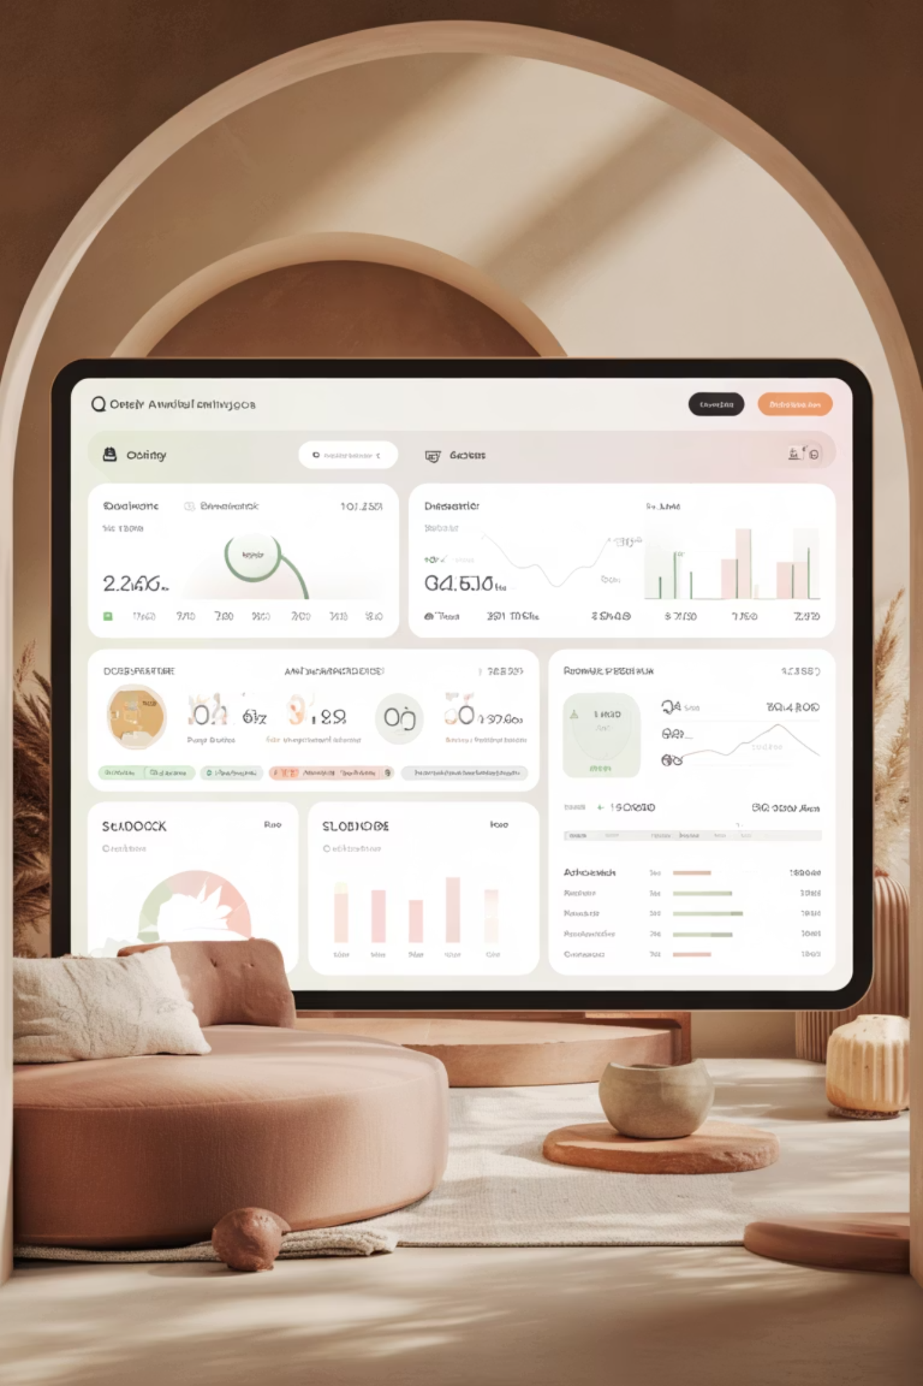
Customer Trend Analysis
Analyzing 3,900 purchases to uncover insights into spending patterns, customer segments, and product preferences that drive strategic business decisions.

Slide 2
Dataset Overview
3,900
18
25
50
Total Purchases
Columns
Product Types
Locations
Transactions analyzed across all categories
Features tracking demographics and behavior
Items across clothing, footwear, and accessories
Geographic coverage across regions
Customer Data
Transaction Details
Age, gender, and location
Product category and pricing
Subscription status
Discounts and promotions
Purchase history and frequency
Review ratings and shipping

Slide 3
Data Preparation & Python Analysis
01
02
03
Data Loading & Exploration
Missing Data Handling
Feature Engineering
Imported dataset using pandas and examined structure with df.info() and summary statistics
Imputed 37 missing Review Rating values using median rating per product category
Created age_group bins and purchase_frequency_days columns for deeper analysis
04
05
Data Consistency
Database Integration
Standardized columns to snake_case and removed redundant promo_code_used field
Connected to MySQL and loaded cleaned data for SQL-based business analysis

Slide 4
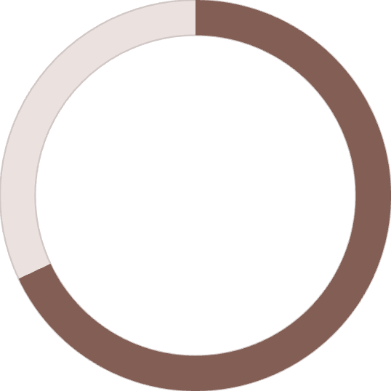
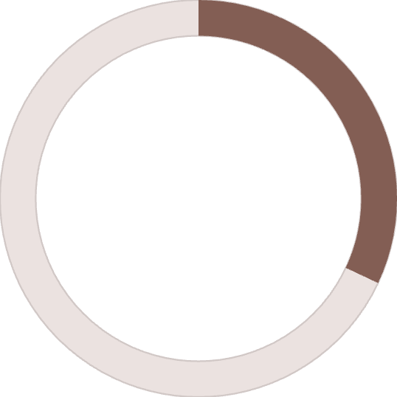
Revenue Insights
$233K
Total revenue analyzed across all customer segments and product categories
68%
32%
Male Customers
Female Customers
$157,890 in revenue
$75,191 in revenue
Male customers generate more than double the revenue of female customers, suggesting opportunities for targeted marketing strategies.

Slide 5


Customer Segmentation Analysis
Loyal Customers
Returning Buyers
3,116 customers (80% of base)
701 customers (18% of base)
Highest value segment with consistent purchase patterns
Growing segment showing repeat purchase behavior
New Customers
83 customers (2% of base)
Entry point for customer acquisition efforts
Key Finding: 958 repeat buyers (>5 purchases) have subscriptions, indicating strong correlation between purchase frequency and subscription adoption.

Slide 6
Product Performance
Top-Rated Products
Most Discount-Dependent
Gloves
50%
3.86 average rating
Hat
Sandals
49.66%
3.84 average rating
Sneakers
Boots
49.07%
3.82 average rating
Coat
Hat
3.80 average rating
48.17%
Sweater
Skirt
3.78 average rating
47.37%
Pants

Slide 7

Subscription & Shipping Analysis
Subscription Impact
Shipping Preferences
Subscribers: 1,053 customers, $59.49 avg spend
Express Shipping
Non-subscribers: 2,847 customers, $59.87 avg spend
$60.48 average purchase
Similar spending patterns suggest untapped subscription potential
Standard Shipping
$58.46 average purchase
Express shipping users spend 3.5% more on average, indicating higher-value customer segment.

Slide 8
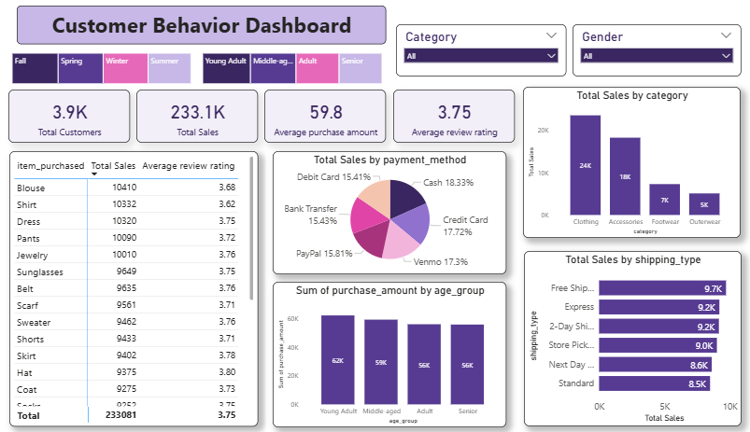
Power BI Dashboard
Interactive visualization presenting revenue trends, customer segments, product performance, and demographic insights for data-driven decision making.

Slide 9

Strategic Recommendations
Boost Subscriptions
Loyalty Programs
Optimize Discounts
Promote exclusive benefits and rewards to convert high-frequency buyers into subscribers
Reward repeat buyers to accelerate movement into the loyal customer segment
Balance promotional sales boosts with margin control for sustainable growth
Product Positioning
Targeted Marketing
Highlight top-rated items like gloves and sandals in marketing campaigns
Focus on high-revenue age groups and express-shipping users for maximum ROI

Slide 10
About Analyst
Prepared by: Neha Pal
Data Analyst | Power BI, SQL, Excel, Python
LinkedIn: www.linkedin.com/in/nehapal3355
Email: neha.pal.3355@gmail.com
Github: https://github.com/DoogoPal

